Slide 1

HIP HOP & STREET DANCE

Slide 2
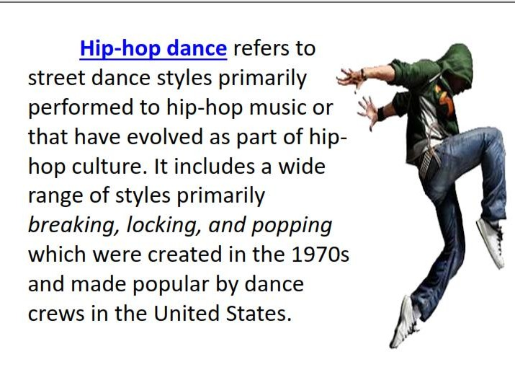

Slide 3
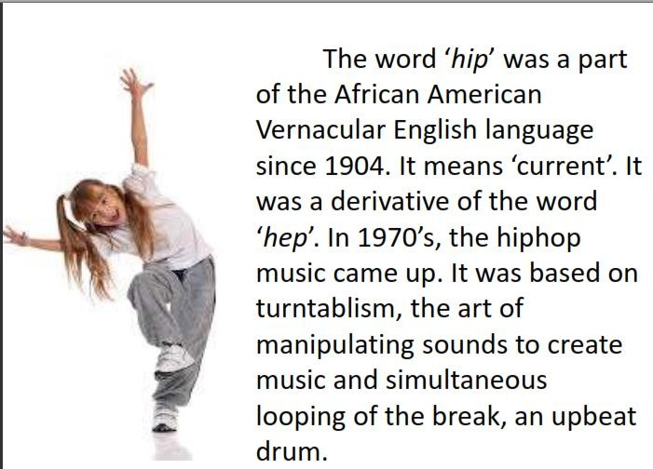

Slide 4
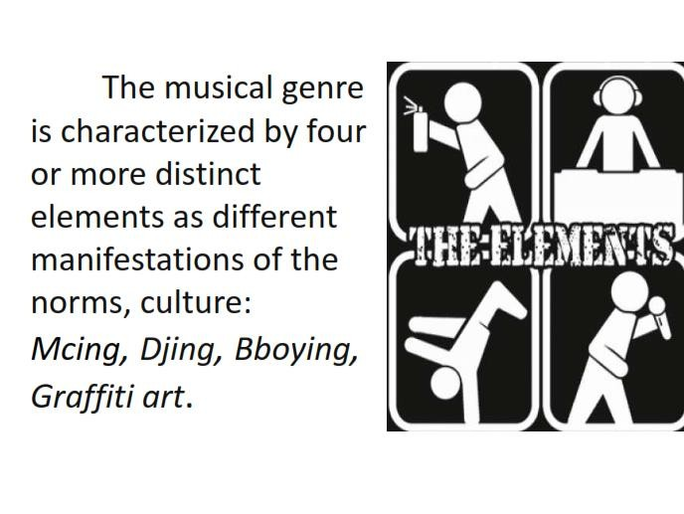

Slide 5
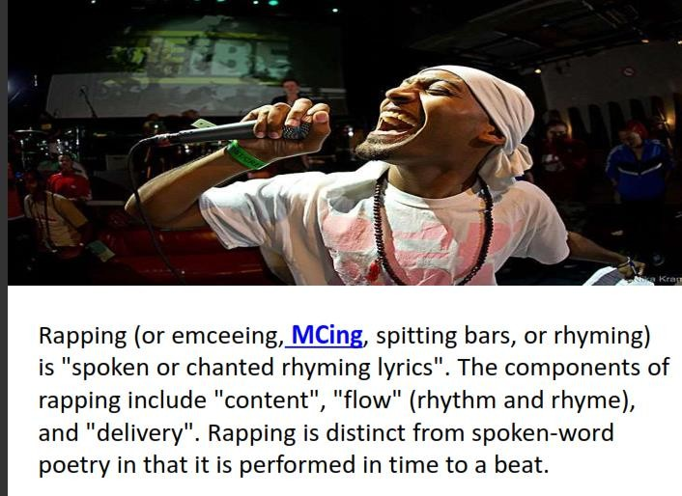

Slide 6
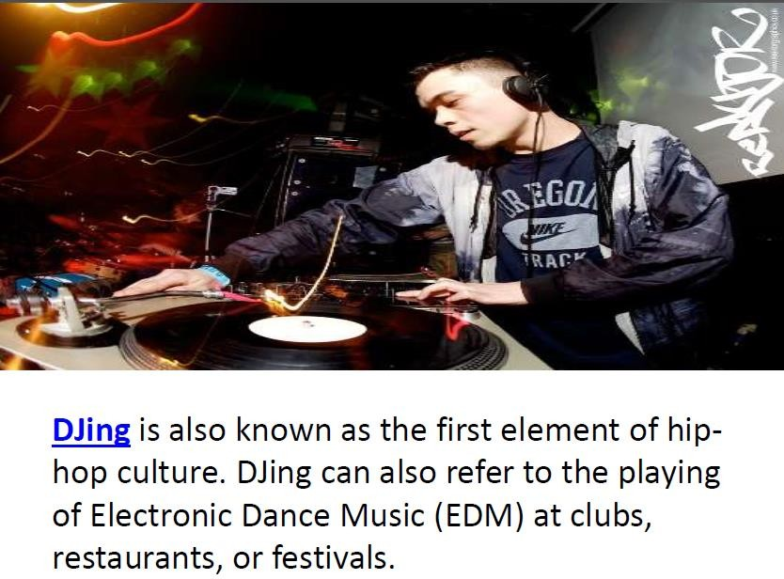

Slide 7
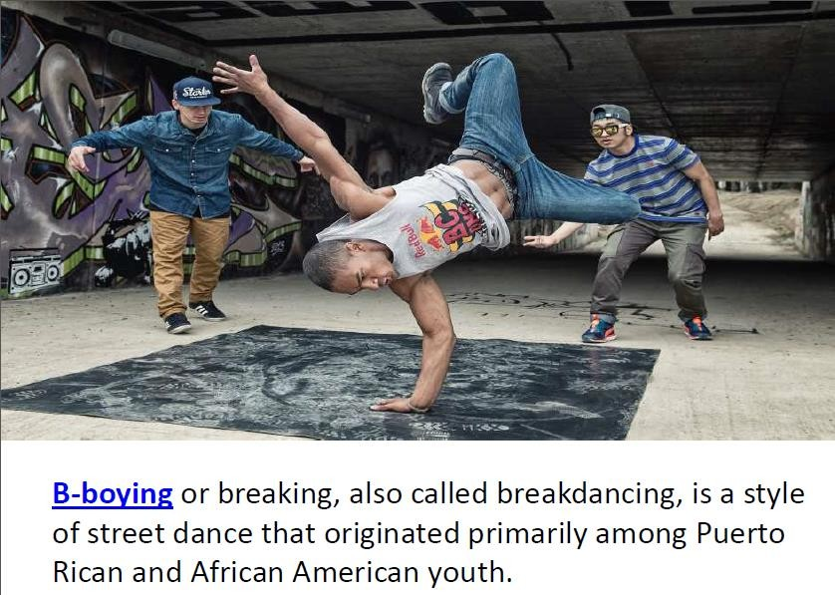

Slide 8
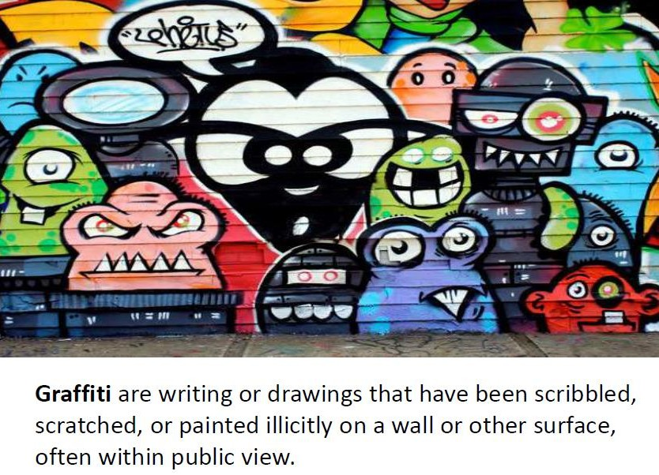

Slide 9
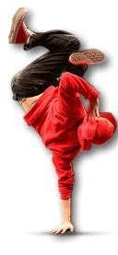
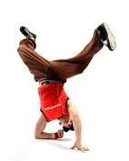
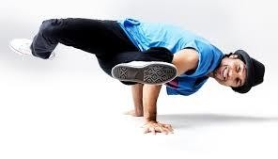
​B-BOYING (Breakdancing)
Breakdancing, also called breaking or b-boying, is an athletic style of street dance.
Breakdancing mainly consists of four kinds of movement:
Toprock
Downrock
Power moves
Freezes.

Slide 10

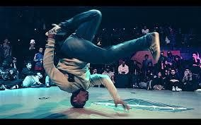
A practitioner of this dance is called a b-boy, b- girl, or breaker.

Slide 11
The dance style originated primarily among Puerto Rican and African American youths (many of them former members of street gangs, such as the Black Spades, the Young Spades, and the Baby Spades) during the mid- 1970s in the Bronx.[1] The dance spread worldwide due to popularity in the media, especially in Canada, France, Germany, Japan, Russia, South Korea and the United Kingdom.

Slide 12
Breakdancing mainly consists of four kinds of movement:
TOPROCK-footwork- oriented steps performed while standing up
DOWNROCK- footwork performed with both hands and feet on the floor
FREEZE- stylish poses done on your hands
Power moves –comprise of full body spins and rotations that give the illusion of defying gravity

Slide 13
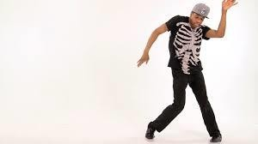
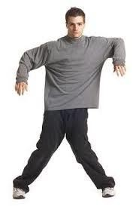
2. POPPING- is a street dance and one of the original funk styles that came from Fresno, California during the late 1960s–1970s.
The dance is based on the technique of quickly contracting and relaxing muscles to cause a jerk in the dancer's body, referred to as a pop or a hit.

Slide 14
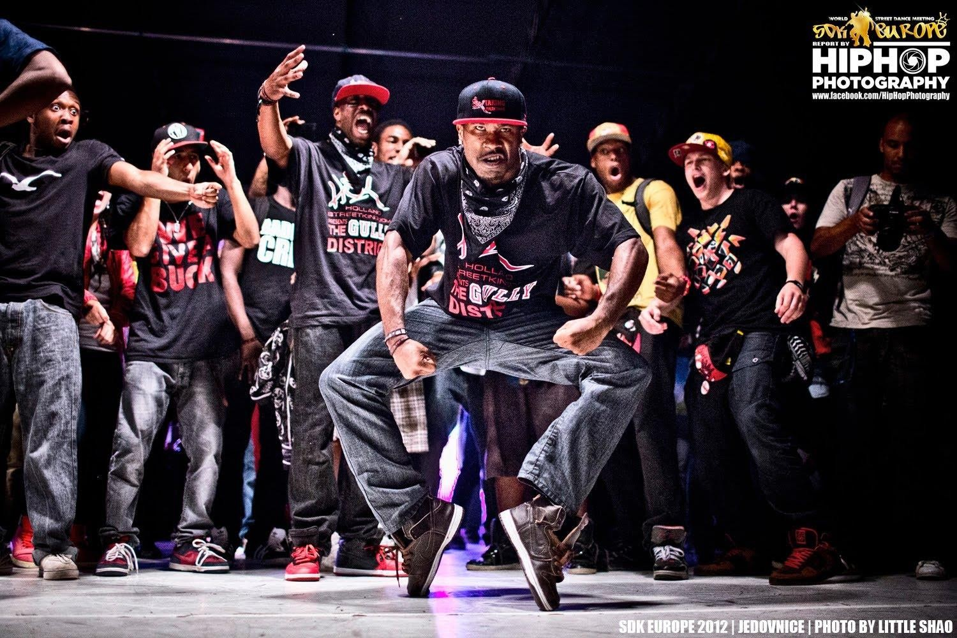

Slide 15
KRUMPING- is a street dance popularized in the United States, characterized by free, expressive, exaggerated, and highly energetic movement.
The youths who started krumping saw the dance as a way for them to escape gang life and "to release anger, aggression and frustration positively, in a non-violent way.”

Slide 16

Krumping was created by two dancers: Ceasare "Tight Eyez" Willis and Jo'Artis "Big Mijo" Ratti in South Central, Los Angeles during the early 2000s

Slide 17
Krumping is rarely choreographed; it is almost entirely freestyle (improvisational)
It is danced most frequently in battles or sessions rather than on a stage
Krumping is very aggressive and is danced upright to upbeat and fast-paced music.

Slide 18
KRUMPING VS BREAKDANCING
Krumping moves are meant to take up space and challenge other dancers to feed off and return the energy whereas Breakdancing is more acrobatic and is danced on the floor to break beats.

Slide 19
Krump: an Acronym for Kindom Radically uplifted mighty praise; Never refer Krump as krumping.
Battle: when competitors face off in a direct dance competition where the use of Concepts, Materials, combos, and Get off takes in place
Biter: someone who attends sessions or watches battles in order to feed on others' styles and originality so that they can mimic those moves later at another battle and pass them off as coming from their own inventiveness.
Session: when a group of Krumpers form a circle,
or cypher in hip-hop context, and one-by-one go into

Slide 20
Buck: an adjective used to describe someone who excels in Krump. it is also used to describe one's movement to be different or out of the Foundations making it worthy for the eyes
Live: an adjective used to describe someone raising the energy in the session or battle.
Call-Out: when a Krumper initiates/requests a battle with another Krumper by calling them out.
Lab: when Krumpers get together or by themselves create new concepts and/or advancing their style

Slide 21
Get-Off: when a Krumper performs a set of movements that determines that a Krumper's round is over, Usually is determined by seeing the krumper doing nothing but foundations, bang outs, or arm-swings.
Kill-Off: when a Krumper performs a set of movements that excites the crowd to the point where the battle is over and the crowd surrounds the Krumper; the opponent is "killed off."[17]
Krumper: A dancer who specializes in the Art of Krump.

Slide 22
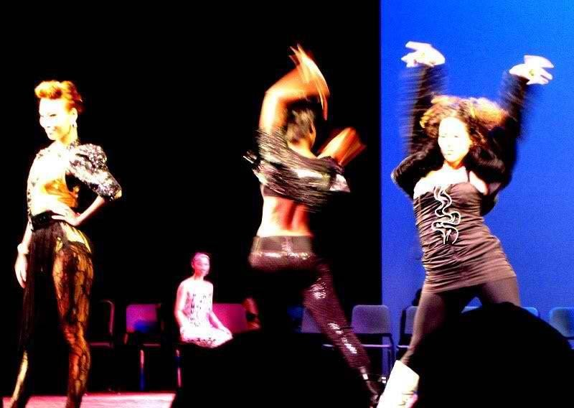
WAACKING
is a form of dance created in the LGBT clubs of Los Angeles, during the 1970s disco era. This dance style was named punking because "punk" was a derogatory term for gay men in the 1970s.

Slide 23

Waacking consists of moving the arms to the music beat typically in a movement of the arms over and behind the shoulder.

Slide 24

SHUFFLING
The basic movements in the dance are a fast heel-and-toe action with a style suitable for various types of electronic music. Most variants also incorporate arm movements.

Slide 25
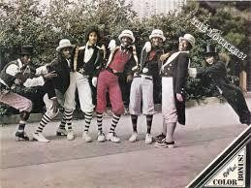
Locking is a style of funk dance, which is today also associated with hip hop. The name is based on the concept of locking movements, which basically means freezing from a fast movement and "locking" in a certain position, holding that position for a short while and then continuing in the same speed as before.

Slide 26
Thank You for Listening
Keep Safe!
Prepared by:
Ms. Kio Mae D. Marvida

